Slide 1
Warehouse Inventory & Reorder System
Tracking products brought in, purchased and returned
Keerthi Chowdary- 2620030196
K.V. Harshini- 2620030195
B.Tech Computer Science | Java

Slide 2

Problem Statement
Stock is often kept in registers or spreadsheets and updated by hand when goods arrive, are sold or come back as returns. A simple program is needed that updates stock automatically for each movement and never lets stock go below zero.
Wrong stock counts
Selling unavailable items
Missed or repeated entries in the register
Orders accepted for stock that is not there
Returns not recorded
No quick stock view
Returned goods never added back to stock
Staff must count shelves to know what is left

Slide 3
Abstract
Small shops and warehouses often record stock by hand, which leads to counting errors and no clear view of what is available. This project presents a simple Java program that tracks the stock of each product through three actions: products brought in from the supplier, products purchased by customers, and products returned by customers.
Stock increases when products are brought in or returned, and decreases when products are purchased. Before a purchase is recorded, the program checks that enough stock is available, so stock never goes below zero. Product names and quantities are stored in arrays, and a report shows the current stock of every product. The program is a base that can later be extended with a database, a user menu and automatic reorder alerts.
Notes:
Read the abstract in your own words. Key point: three actions change stock, and a purchase is checked first.

Slide 4


Objectives and Tools
Objectives
Tools used
Record products brought in from the supplier
Record products purchased by customers
Record products returned by customers
Block purchases larger than available stock
Show current stock of all products
Language: Java
Data storage: arrays (in memory)
Software: VS Code
Compiler: JDK (javac and java)

Slide 5



How It Works: Three Actions
Brought in
Purchased
Returned
bringProduct()
purchaseProduct()
returnProduct()
Goods arrive from the supplier
Customer buys goods; stock is checked first
Customer sends goods back
Stock goes UP
Stock goes DOWN
Stock goes UP

Slide 6
Purchase Check Logic
Yes: show "Sorry, only N available"
Is quantity more than stock?
Customer orders quantity
No: stock = stock - qty

Slide 7
1
Module 1
Java Foundations & Program Model
TOPIC FROM THE SYLLABUS
WHAT IT DOES IN THIS PROJECT
Primitive data types, variables, constants
Operators: arithmetic, relational, logical, ternary, unary, bitwise
Typecasting and expression evaluation
Console I/O: formatted printing, Scanner
Product fields hold code, name, quantity, price and reorder point
FRAGILE and COLD packed into one int using bitwise flags
LOW or OK status decided by a ternary operator
Average cast from int to double; every report printed with printf
IN THE CODE
class Product · readInt() · status()

Slide 8
2
Module 2
Control Flow: Selection & Iteration
TOPIC FROM THE SYLLABUS
WHAT IT DOES IN THIS PROJECT
if, if-else, nested if, if-else-if ladder
switch with break and default
while, do-while and for loops
continue, infinite loops, nested loops
The 10-option menu runs on a switch inside a while loop
Every movement checks first that the product exists
do-while keeps asking until the typed quantity is valid
Nested loops walk the rack rows and shelves to total it
IN THE CODE
menu() · readInt() · arrayStats()

Slide 9
3
Module 3
Methods, Recursion & Arrays
TOPIC FROM THE SYLLABUS
WHAT IT DOES IN THIS PROJECT
Method definition, invocation, parameter passing
Return values and method overloading
Enhanced for-each loop
Recursion: base case and recursive case
1D arrays and 2D matrix arithmetic
returnGoods() written twice, with and without a reason
Quantities copied to an array for total, average, max and count
netEffect() calls itself down the ledger until the base case
Rack stored as int[3][4] and totalled by row
IN THE CODE
returnGoods() x2 · arrayStats() · netEffect()

Slide 10
4
Module 4
OOP Modelling, Design & Exceptions
TOPIC FROM THE SYLLABUS
WHAT IT DOES IN THIS PROJECT
Classes as blueprints, objects as instances, new
Constructors, overloading, this, encapsulation
Static members, toString(), inheritance, overriding
Checked vs unchecked exceptions
try-catch-finally, multi-catch, throw, throws
Product keeps its fields private, reached through getters
Inward, Purchase and Return all extend the abstract Txn class
Each child overrides type() and effect() differently
NoStockException is thrown on an oversized order and caught
IN THE CODE
class Txn + 3 children · NoStockException · doPurchase()

Slide 11
5
Module 5
Strings, Library Algorithms & File I/O
TOPIC FROM THE SYLLABUS
WHAT IT DOES IN THIS PROJECT
String immutability, length, substring, concatenation
equals() vs == : value against reference
StringBuilder for mutable text
split(), join(), trim(), tokenising records
Arrays.sort(), binarySearch(), Comparable, Comparator
Files and Path, buffered writer, try-with-resources
A CSV record is trimmed, split, re-joined and reduced to initials
equals and == shown side by side giving different answers
Stock list sorted by code, then searched with binary search
Products written to products.csv and read back again
A damaged row is skipped instead of stopping the program
IN THE CODE
stringDemo() · saveToFile() · loadFromFile() · toCsv()

Slide 12
6
Module 6
Collections Framework & Streams
TOPIC FROM THE SYLLABUS
WHAT IT DOES IN THIS PROJECT
List, Set, Map as practical APIs
ArrayList, HashMap, HashSet; generics and autoboxing
Lambda expressions and method references
Predicate, Function, Comparator
Stream pipelines: filter, map, sorted, distinct, limit
Collectors: toList, groupingBy, counting, joining
Products in a HashMap, found instantly by their code
Ledger in an ArrayList that keeps its order
Suppliers in a HashSet that ignores repeats
Lambdas decide what to keep; method references what to measure
Reports: low stock, total value, units per category, top three
IN THE CODE
streamReports() · static collections in Warehouse

Slide 13
GitHub Link
https://github.com/nadendlakeerthichowdary-arch/KLH-PSPJ-S16-1-TEAM-NO.-15-

Slide 14
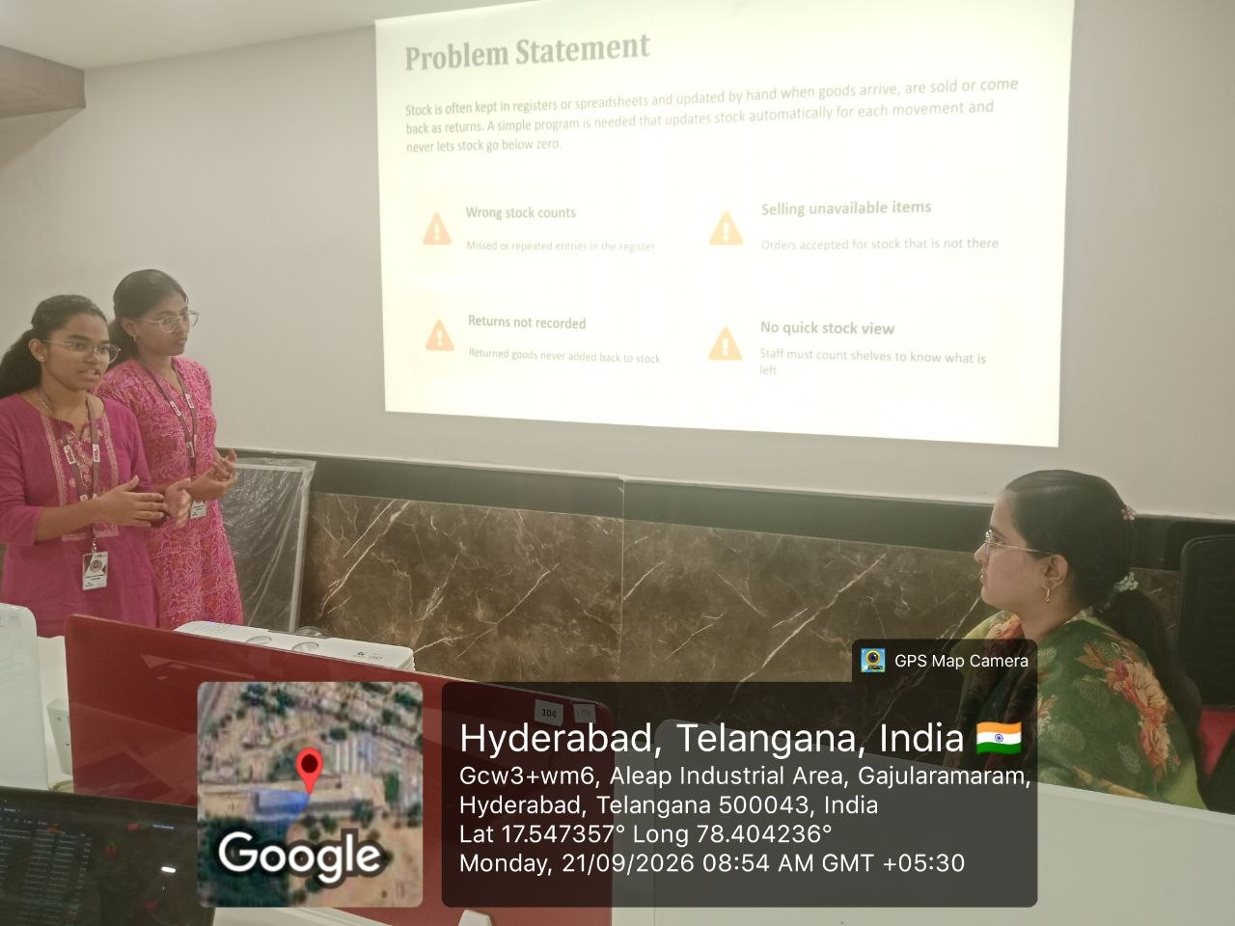
Geo-tag photo

Slide 15


